Slide 1

An insightful look at IMDB data from 2006 and 2016
Team Members: Mahtab Karimipour, Luke Gonzales, Molly Eskelson

Slide 2

An insightful look at IMDB
data from 2006 and 2016

Slide 3
Motivation & Summary
How do people define a good movie? What is a good movie?
Our project is to uncover patterns between movies released from 2006 and 2016 and their genres, critic scores, revenue, actors, directors, year, runtime minutes, rating, votes, and metascore. As the data allows.
Notes:
* Define the core message or hypothesis of your project.
* Describe the questions you asked, and _why_ you asked them
* Describe whether you were able to answer these questions to your satisfaction, and briefly summarize your findings

Slide 4
Questions & Data
How much revenue do movies make per a genre?year?
What are the best/top 15 movies according to revenue? Year?
What is the average rating for movies? (by each genre?) then what would be a good or bad movie rating score (rating vs metascore)?
Does the length of run time effect a movies rating?
Is there a relationship between a movies revenue and the rating users give it?
Analyzing the difference between meta score(critiques) and users(rating)
Who are the top directors and actors- actors and directors show up in the most films in this 10 year span

Slide 5

Data set
Here's a data set of 1,000 “most popular” movies on IMDB in the last 10 years. The data fields included are:
Title, Genre, Description, Director, Actors, Year, Runtime, Rating, Votes, Revenue, Metascrore
Rank-Movie rank order
Title-The title of the film
Genre-A comma-separated list of genres used to classify the film
Description-Brief one-sentence movie summary
Director-The name of the film's director
Actors-A comma-separated list of the main stars of the film
Year-The year that the film released as an integer.
Runtime (Minutes)-The duration of the film in minutes.
Rating-User rating for the movie 0-10
Votes-Number of votes
Revenue (Millions-)Movie revenue in millions
Metascore-An aggregated average of critic scores. Values are between 0 and 100. Higher scores represent positive reviews.
Source- Kaggle.com

Slide 6
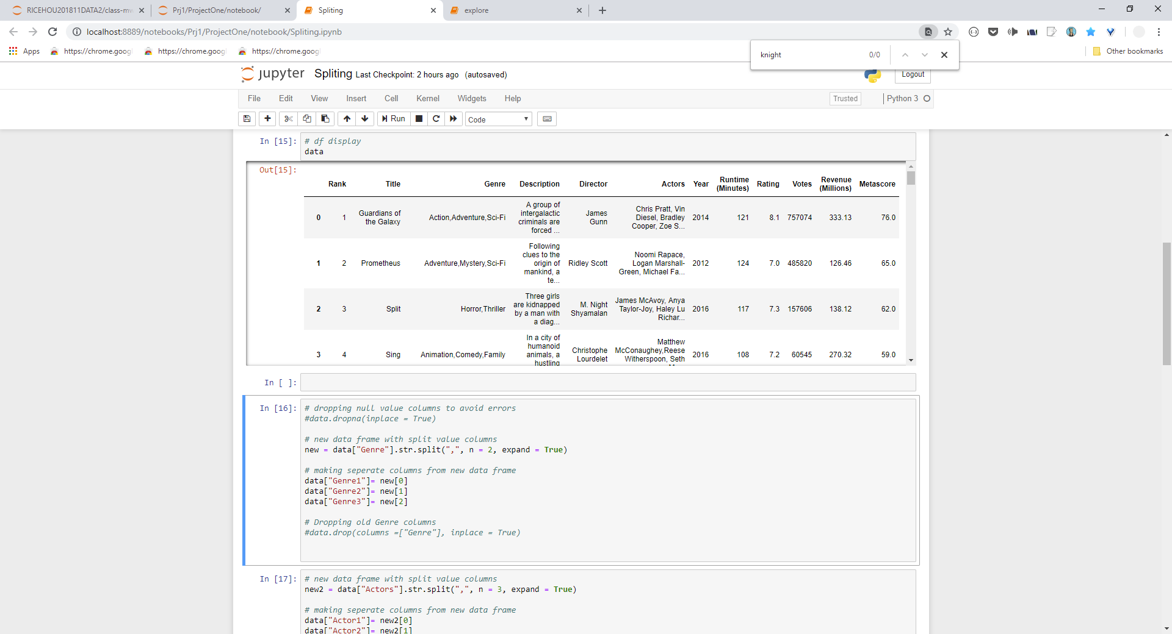
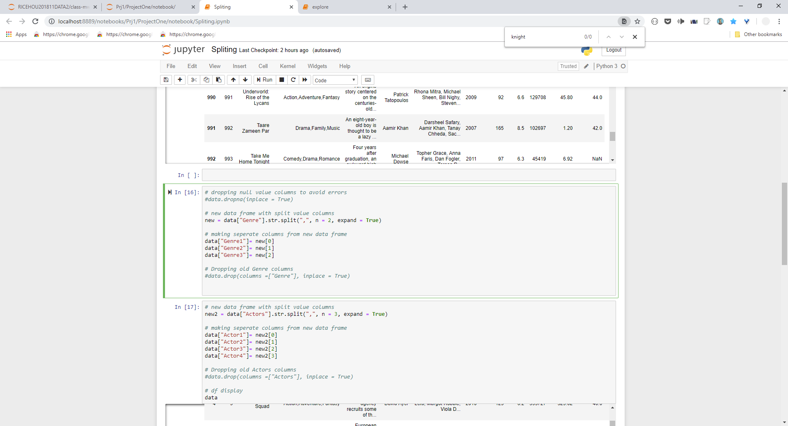
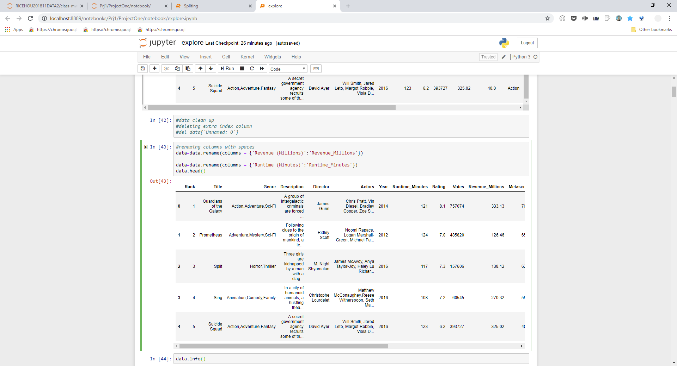
Data Cleanup & Exploration
Split up columns actor and genre using python
Groupby on columns such as genre and Revenue
dictionary
Sorted and query
Notes:
* Describe the exploration and cleanup process
* Discuss insights you had while exploring the data that you didn't anticipate
* Discuss any problems that arose after exploring the data, and how you resolved them
* Present and discuss interesting figures developed during exploration, ideally with the help of Jupyter Notebook

Slide 7
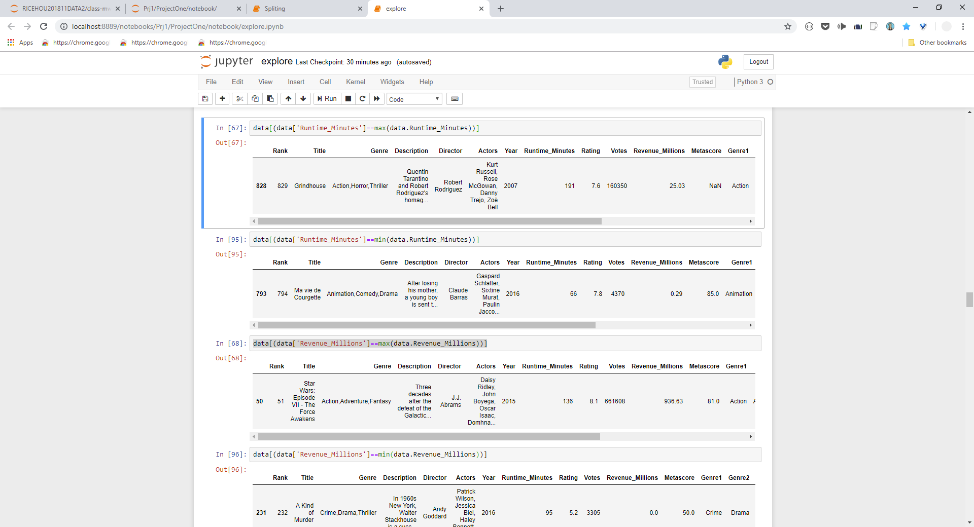




Interesting Figures
Notes:
* Discuss the steps you took to analyze the data and answer each question you asked in your proposal
Present and discuss interesting figures developed during analysis, ideally with the help of Jupyter Notebook
What is the be best movies according to revenue?
In the dataset, the movie that brought in the most millions of dollars is the movie “Star Wars: Episode VII – The Force Awakens” with 936.66 million dollars released in 2015.

Slide 8
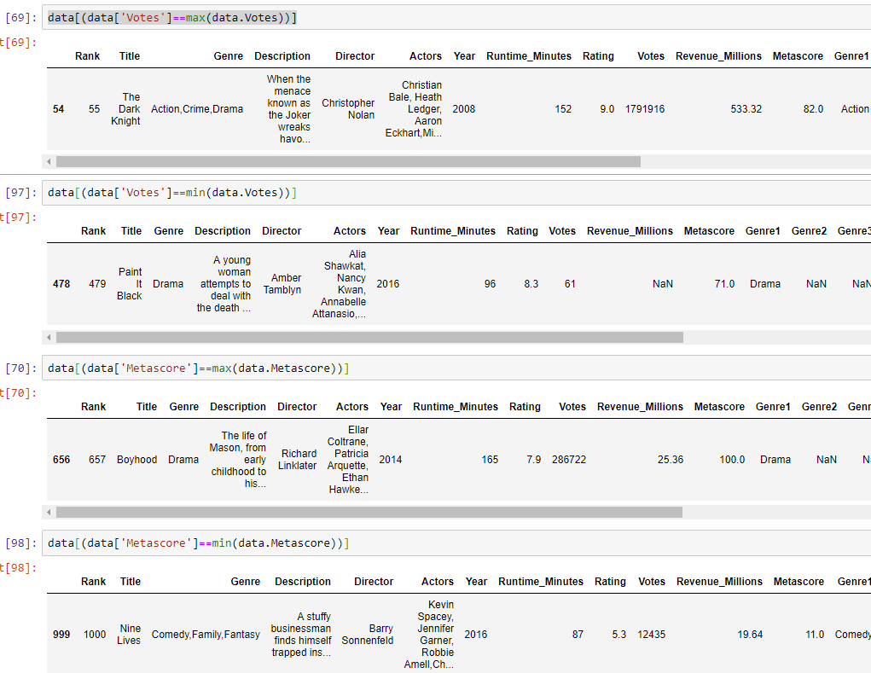





Slide 9
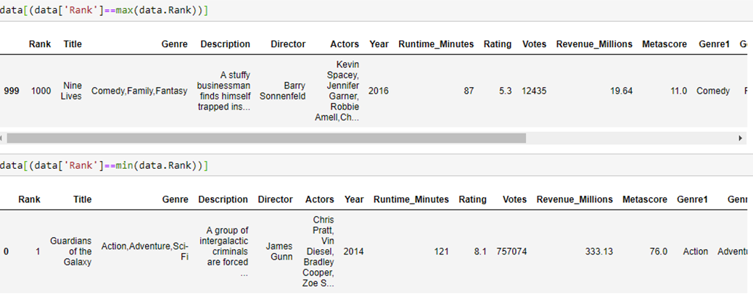


Slide 10
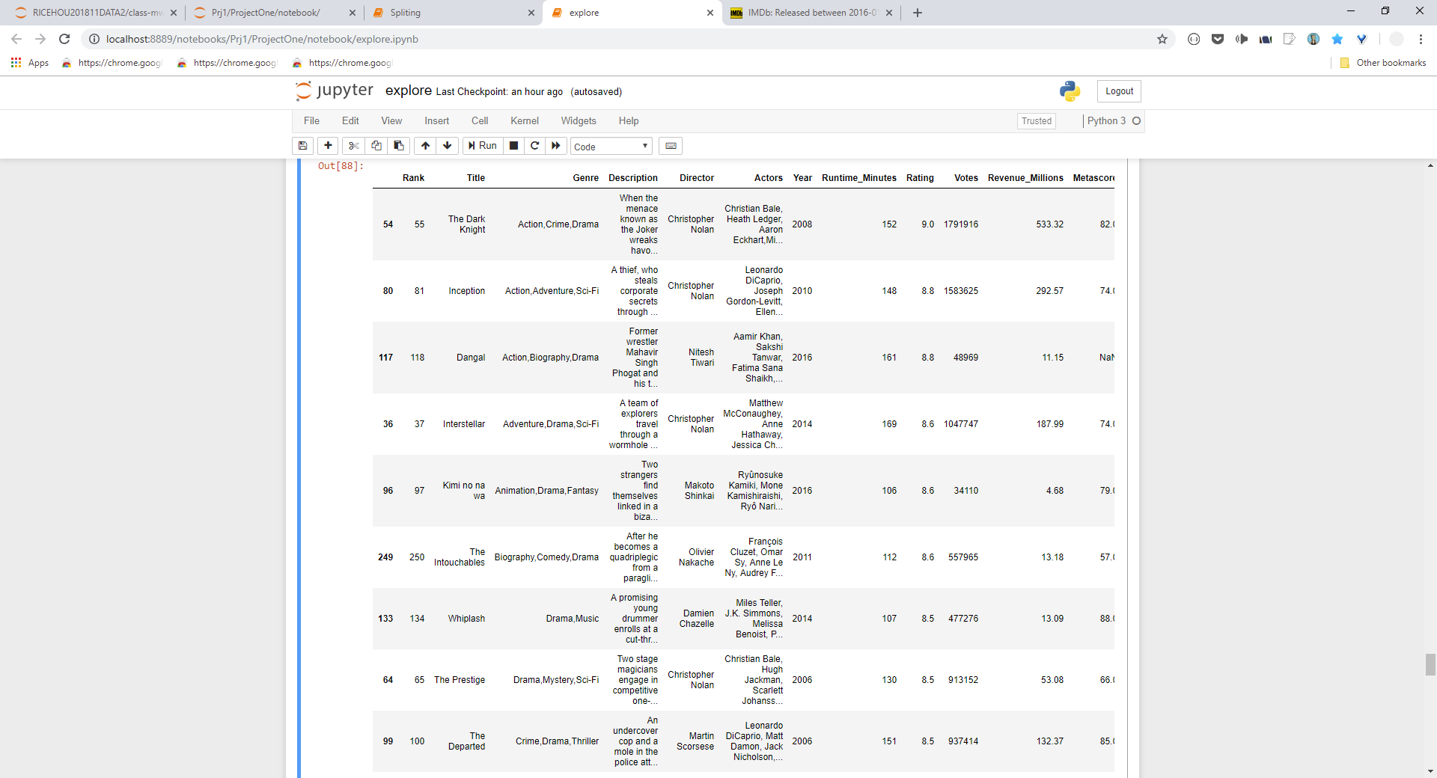
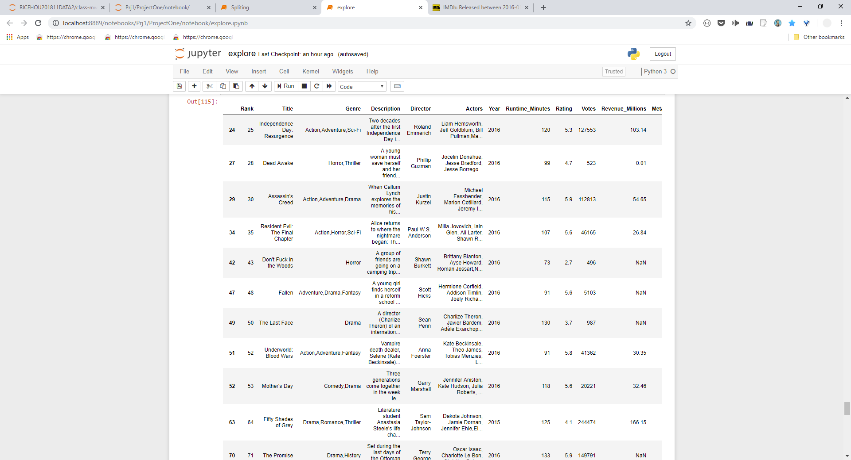
Rating
Sortedrating.head(10)
lowratedmovies.head(10)
Notes:
Most of all low rated movies are from 2016.
Looking up the release date of all the films we figured out that the reason these 216 movies were getting low ratings or none at all was because they hadn’t been out long enough to accumulate a reflective rating/viewership that year.

Slide 11









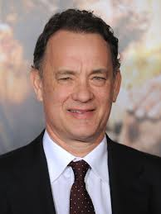



Top actors
Actors | movies
Christian Bale | 11
Mark Wahlberg | 11
Will Smith | 9
Denzel Washington | 9
Brad Pitt | 9
Leonardo DiCaprio | 9
Jake Gyllenhaal | 9
Adam Sandler | 9
Johnny Depp | 8
Tom Hanks | 8
1
4
2
5
Busiest actors
in this 10 year span.
3
2
6
7
9
8
10

Slide 12




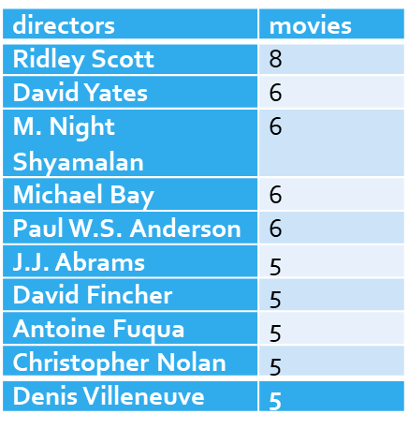


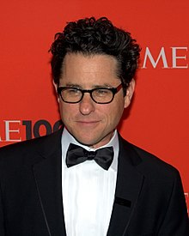





Top ten directors
1
The list of directors that made the most movies in 10 years period.
2
3

Slide 13
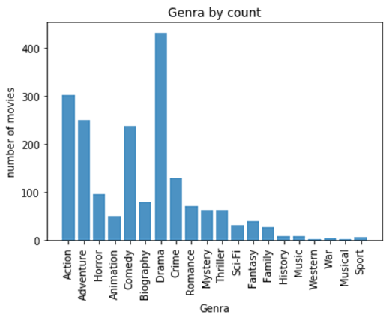
Genre by count

Slide 14
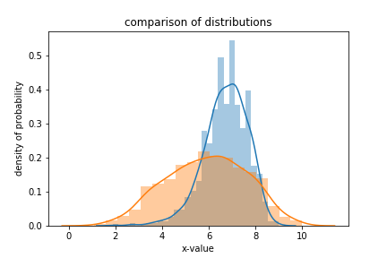
Meta score VS ranking critic V users

Slide 15
T-test findings
Because the p value was less than α
Able to reject the null
Rating and meta score are not the same.
critiques and user have different rating systems for what makes a movie good or not.
Notes:
Exprected to find(positive): that critiques and user have different rating sysems for what makes a movie good or not.

Slide 16
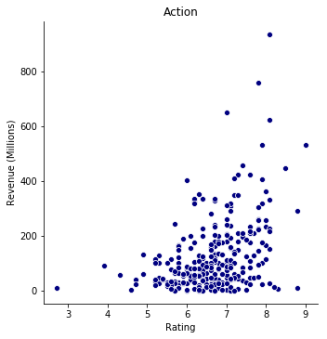
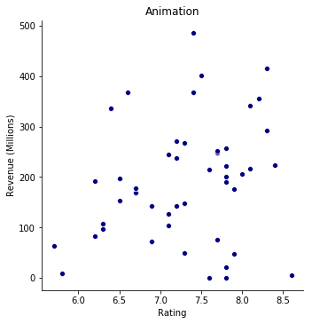
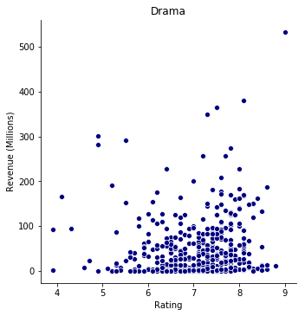

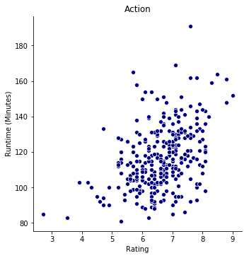
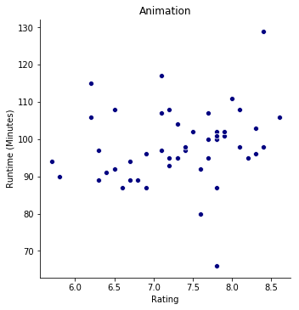
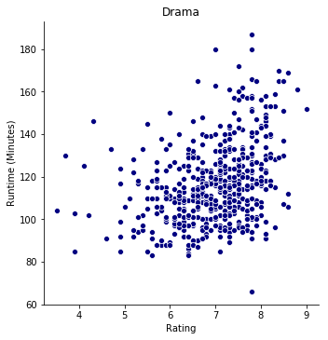
Runtime vs Revenue by Rating
Revenue (millions)
Animation
Drama
Runtime
Notes:
Is the a niche runtime that makes the most money? Does runtime effect peoples pleasure at the movies

Slide 17
Conclusion
What is the be best movies according to revenue?
In the dataset, the movie that brought in the most millions of dollars is the movie “Star Wars: Episode VII – The Force Awakens” with 936.66 million dollars released in 2015.
What is the average rating for movies? 6.2
then what would be a good or bad movie rating score (rating or metascore)?
For rating: Good >=6.7<=bad metascore: Good >=60 <=bad
Does the length of run time effect a movies rating? No.

Slide 18
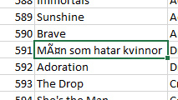
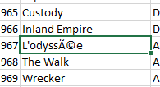
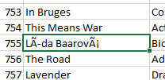
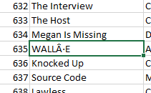
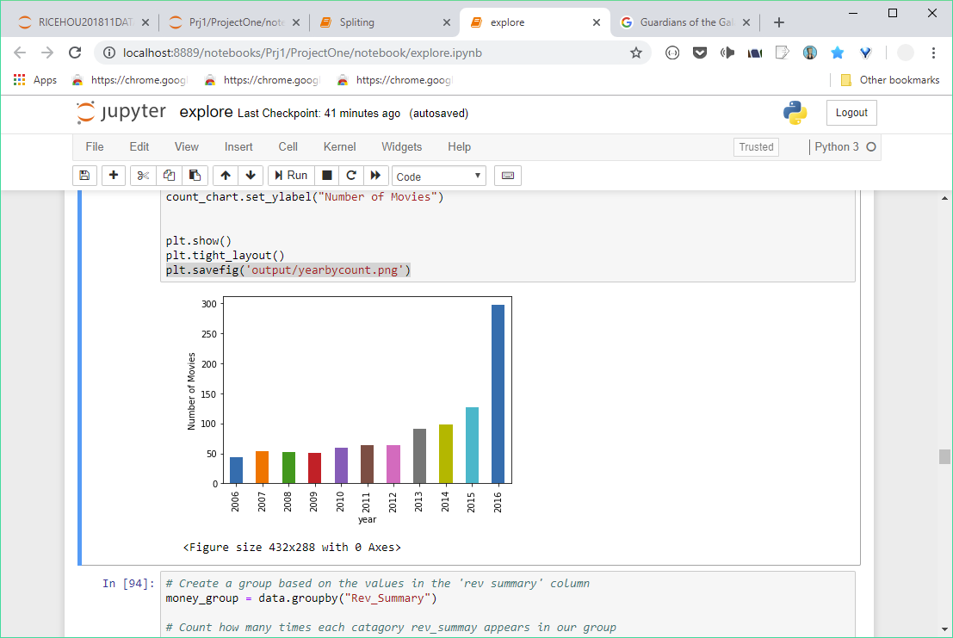
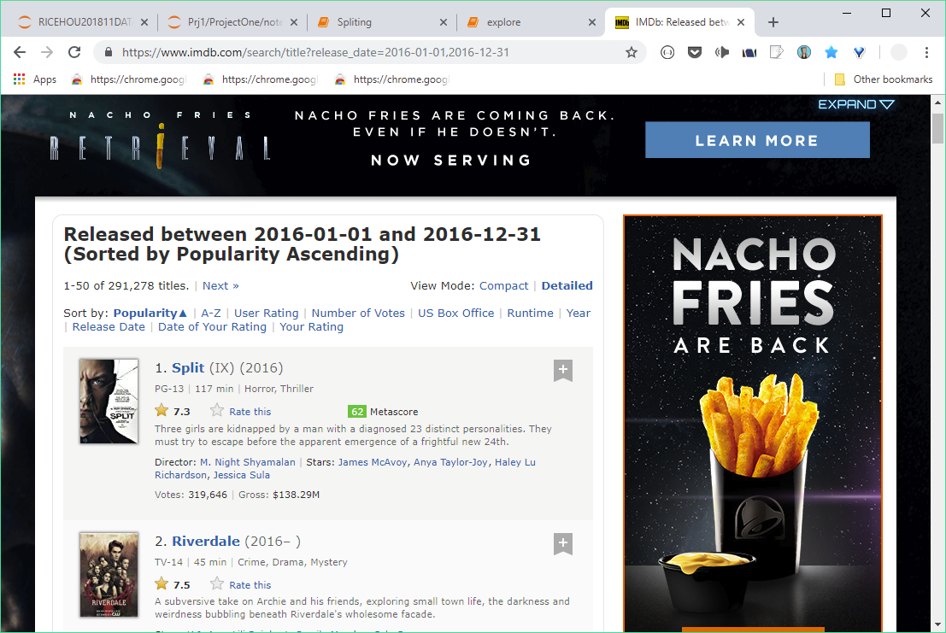
Post Mortem
Our data was limited.
How are movie genres categorized?
Our next research question was do these results/rankings stand true across all major user voting websites (rotten tomatoes, Fandango, etc.)
Notes:
Discuss any difficulties that arose, and how you dealt with them
Discuss any additional questions that came up, but which you didn't have time to answer: What would you research next, if you had two more weeks?
Originally we were doing a project on yelp dataset but after experiencing difficulties with both the excel and JSON versions of the dataset we unanimously agreed to moved on to another project.
Data was limited:
Our next research question was do these results/rankings stand true across all major user voting websites (rottentomatos)

Slide 19



Questions

